Slide 1
Anti-Reflective Coatings
Xin Yang
10/30/2018

Slide 2
Outline
Problems caused by reflection
  Standing Wave
  Swing Curve Effect
  Reflective Notching
Solutions: Anti-Reflective Coatings
  Top Anti-Reflective Coatings (TARC)
  Bottom Anti-Reflective Coatings (BARC)

Slide 3
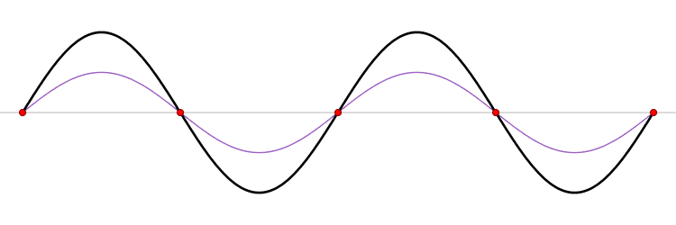
Standing wave
Interference of two waves of the same frequency and amplitude propagating in opposite direction.
  Node: the peak amplitude is minimum; destructive interference
  Anti-node: the amplitude is maximum; constructive interference
Oscillates in time but peak amplitude profile does not move in space

Slide 4
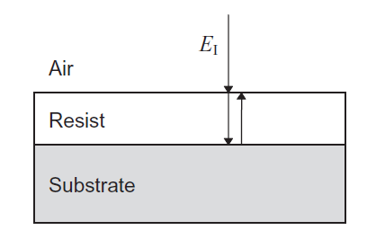
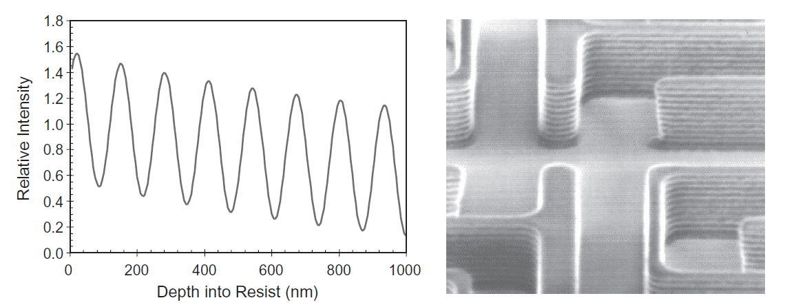
Standing wave
Scalloping of sidewall, reducing critical dimension control
Chris A. Mack, Fundamental Principles of Optical Lithography, (c) 2007

Slide 5
Swing curve effect
Generically, a swing curve refers to the sinusoidal variation of some lithographic parameter with resist thickness.
Interference of E_{r0} and E_{r1}
  Film thickness variation
  Constructive/destructive interference
  Energy into resist varies
Chris A. Mack, Fundamental Principles of Optical Lithography, (c) 2007

Slide 6
Swing curve
Linewidth swing curve
  sinusoidal variation
  Increasing trend
Chris A. Mack, Fundamental Principles of Optical Lithography, (c) 2007

Slide 7
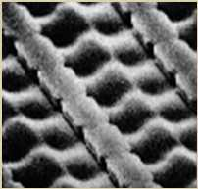
Reflective notching
Incident light reflects off of wafer topography and into an area where resist exposure is not desired.
Light scattering
Irregular shape
Chris A. Mack, Fundamental Principles of Optical Lithography, (c) 2007
AZ Electronic Materials

Slide 8
Solutions
Increase absorption in the resist
  add a dye to the photoresist
Use broadband (polychromatic) illumination
  average out the peaks.
Reduce the reflectivity
  use anti-reflective coatings (ARCs)

Slide 9
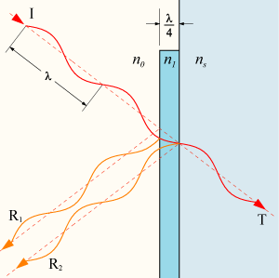
Anti-Reflective Coatings
Applied to the surface of lenses and other optical elements to reduce reflection.
Destructive interference
    R₁ and R₂ have the same intensity
    R₁ and R₂ are 180⁰ out of phase
    No reflection from the surface
    All the energy of the beam must be in the transmitted ray, T

Slide 10
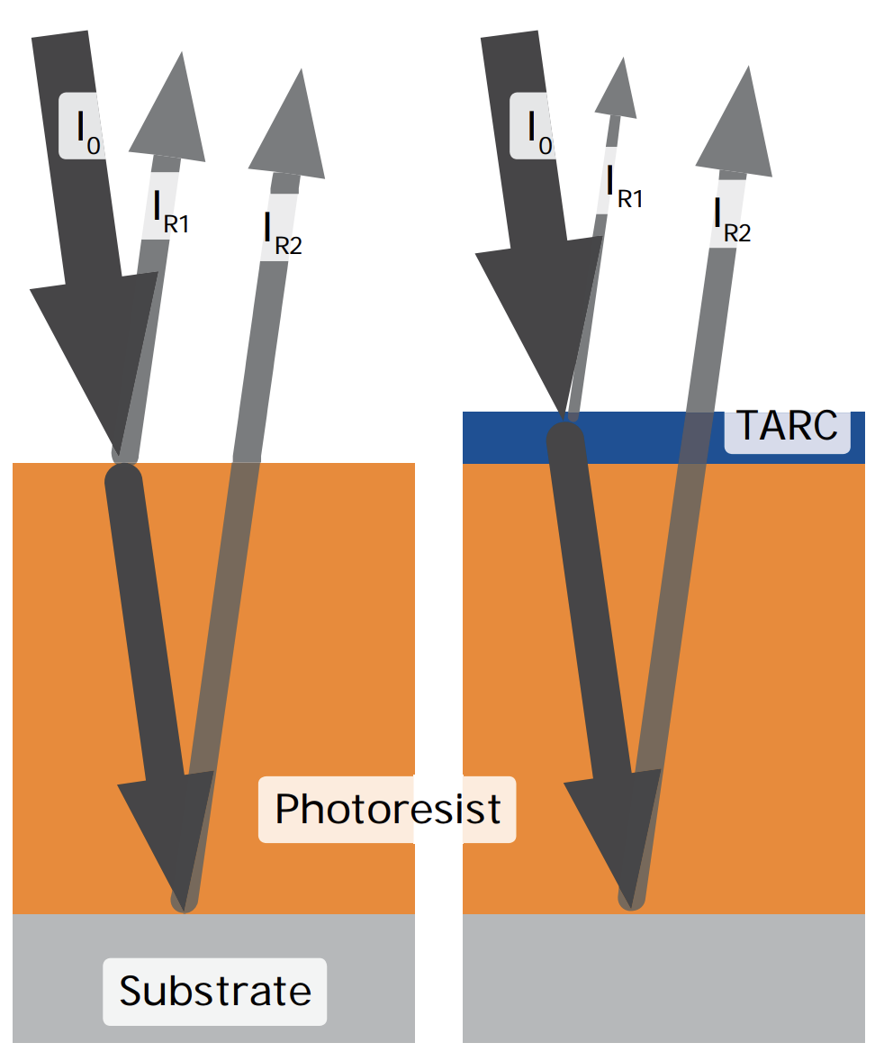
Top Anti-Reflective Coatings
Spin on top of resist layer
Reduce the swing curve effect
Destructive interference
  n (index of refraction)
  𝜿 (mass attenuation coefficient)
  D (BARC film thickness)
Not Perfect
  Resist always absorbs
MicroChemicals, Anti-Reflective Coatings, 2013

Slide 11
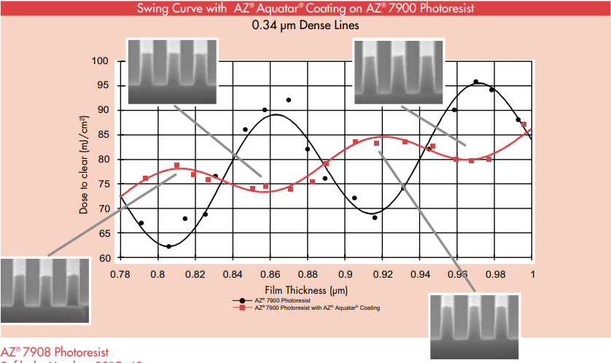
Top Anti-Reflective Coatings
Spin on top of resist layer
Reduce the swing curve effect
Destructive interference
  n (index of refraction)
  𝜿 (mass attenuation coefficient)
  D (BARC film thickness)
Not Perfect
  Resist always absorbs
MicroChemicals, Anti-Reflective Coatings, 2013

Slide 12
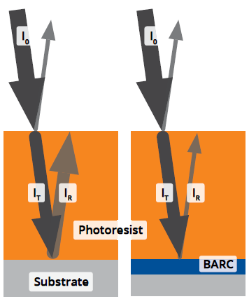
Bottom Anti-Reflective Coatings
Reflection off the substrate is reduced/eliminated.
  n (index of refraction)
  𝜿 (mass attenuation coefficient)
  D (BARC film thickness)
Reduce standing wave and swing curve effect
MicroChemicals, Anti-Reflective Coatings, 2013

Slide 13
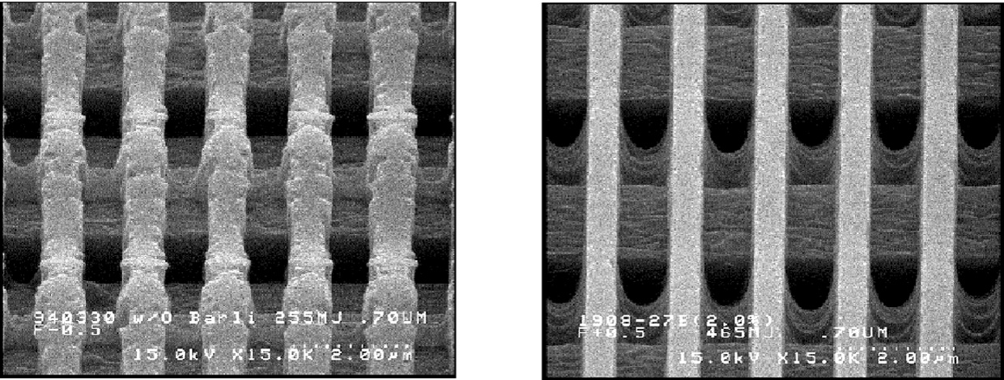
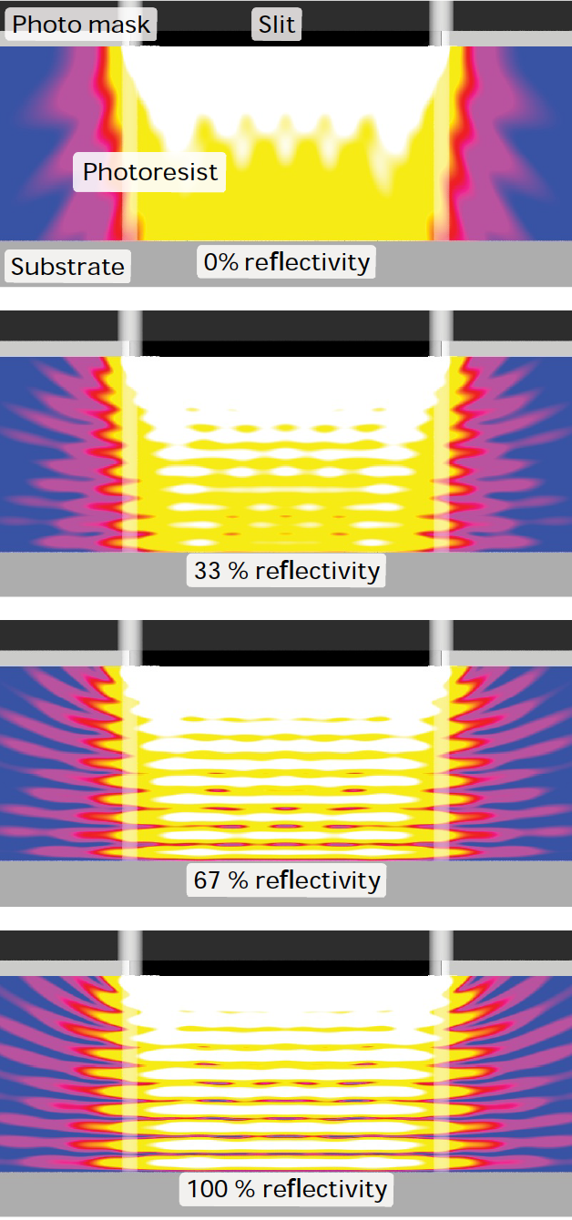
Bottom Anti-Reflective Coatings
The simulated spatial distribution of the light intensity as a function of the substrate reflectivity
Chris A. Mack, Fundamental Principles of Optical Lithography, (c) 2007;
MicroChemicals, Anti-Reflective Coatings, 2013

